Slide 1
Lecture 6d: Control Design
To watch lecture video click link below
Lecture 6d video
To view slides, continue to next slide

Slide 2
Lecture 6d: Control Design
ALU Control Unit

Slide 3
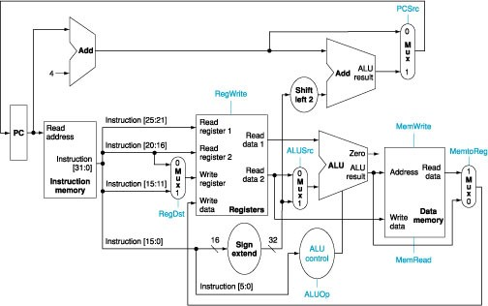
ALU Control on Datapath

Slide 4
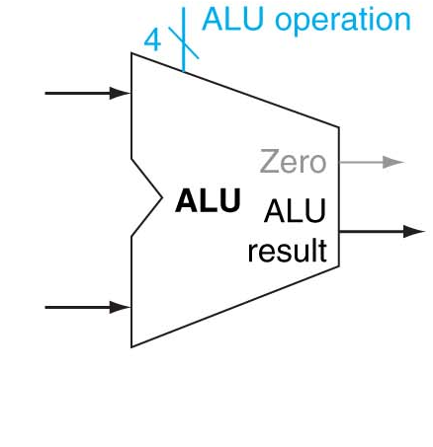
ALU Control (recap Lecture 6a)
Operation | Function
0000 | AND
0001 | OR
0010 | ADD
0110 | SUB
Let’s name the ALU control signals as ALU Operation, simply Operation. Since the first bit is always 0, we will ignore it. We only need to figure out the rest 3 bits which we name as Op₂, Op₁, Op₀.

Slide 5
ALU Control
What should be the values of the 3-bit ALU control signals?
  Classify the instructions into the following categories:
  lw, sw ALU performs add (i.e. add offset to base address)
  beq ALU performs sub (for comparison of two operands)
  R-type ALU operations depend on the funct code
  (R-type instructions share the same opcode 000000, but differ in funct code.)
Instruction | ALU action | ALU Control Signal (Operation)
lw/sw | add | 010
beq | sub | 110
R-type (funct 0x24) | and | 000
R-type (funct 0x25) | or | 001
R-type (funct 0x20) | add | 010
R-type(funct 0x22) | sub | 110

Slide 6
ALU Control
How to represent the different categories of instructions?
  We can tell which instruction it is from the instruction’s opcode;
  The main control (to be discussed) will check opcode for decoding;
  During the decoding stage, it will generate a 2-bit control signal, named ALUOp to tell ALU control unit the instruction category.
Instruction(s) | ALUOp (generated by main control)
lw/sw | 00
beq | 01
R-type | 10

Slide 7
Instruction | ALU action | ALU Control Signal (Operation)
lw/sw | add | 010
beq | sub | 110
R-type (funct 0x24) | and | 000
R-type (funct 0x25) | or | 001
R-type (funct 0x20) | add | 010
R-type(funct 0x22) | sub | 110
ALUOp | Funct | Operation
00 (lw/sw) | xxxxxx (don’t care) | 010
01 (beq) | xxxxxx | 110
10 (R-type) | 100100 (0x24 => and) | 000
10 (R-type) | 100101 (0x25=>or) | 001
10 (R-type) | 100000 (0x20 => add) | 010
10(R-type) | 100010 (0x22 => sub) | 110

Slide 8
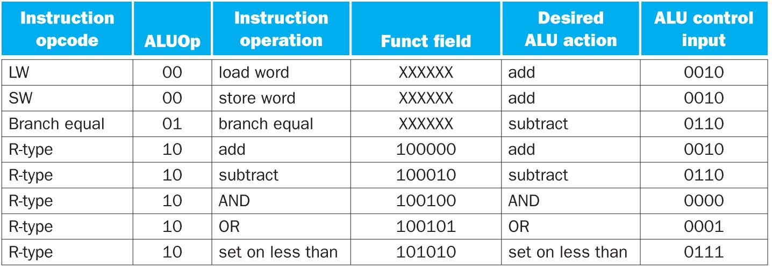
Instructions and ALU Control Input
(textbook view)
Note: the last instruction slt not considered for this class.

Slide 9
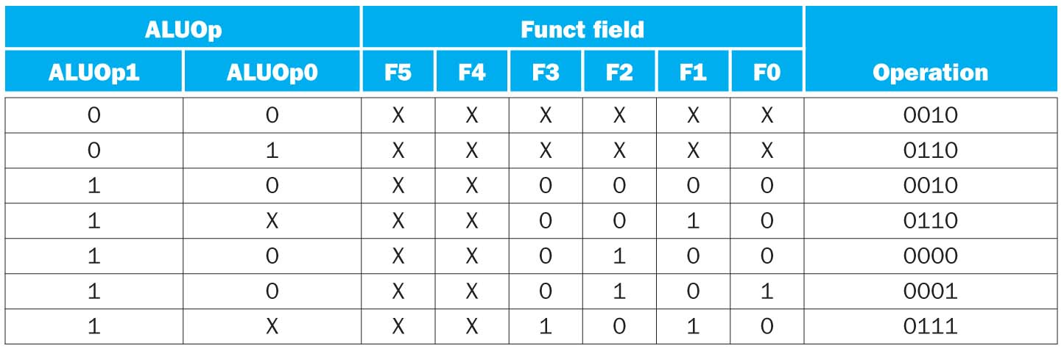
ALU Control: Truth Table
ALU control input/output relation described in previous slide can be converted to a truth table
  again, ignore the last row

Slide 10
ALU Control Implementation
(without leftmost bit)
Note: for this class, circuit implementation as optional material, however, ability to construct truth table is required.

Slide 11
ALU Control Abstraction
4-bit Operation
that controls ALU
ALU Control
Funct – 6 bits from Instruction[5:0]
ALUOp (2-bit signal from main control)

Slide 12
A Simple Implementation Scheme
Next, we will discuss main control unit.

